Slide 1
Install Hadoop on Ubuntu
CSC 4760 / 6760 Big Data Programming
Spring 2018

Slide 2
Install Hadoop on Ubuntu 16.04
How to Install Hadoop in Stand-Alone Mode on Ubuntu 16.04 ?
https://www.digitalocean.com/community/tutorials/how-to-install-hadoop-in-stand-alone-mode-on-ubuntu-16-04
Hadoop: Setting up a Single Node Cluster
https://hadoop.apache.org/docs/stable/hadoop-project-dist/hadoop-common/SingleCluster.html

Slide 3
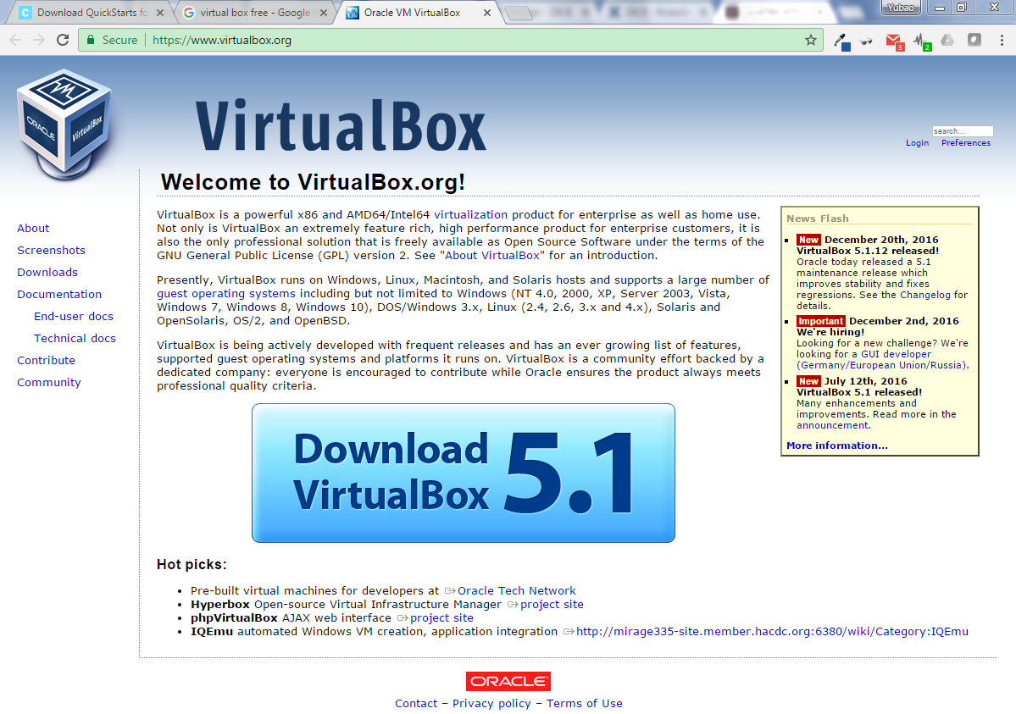

Slide 4
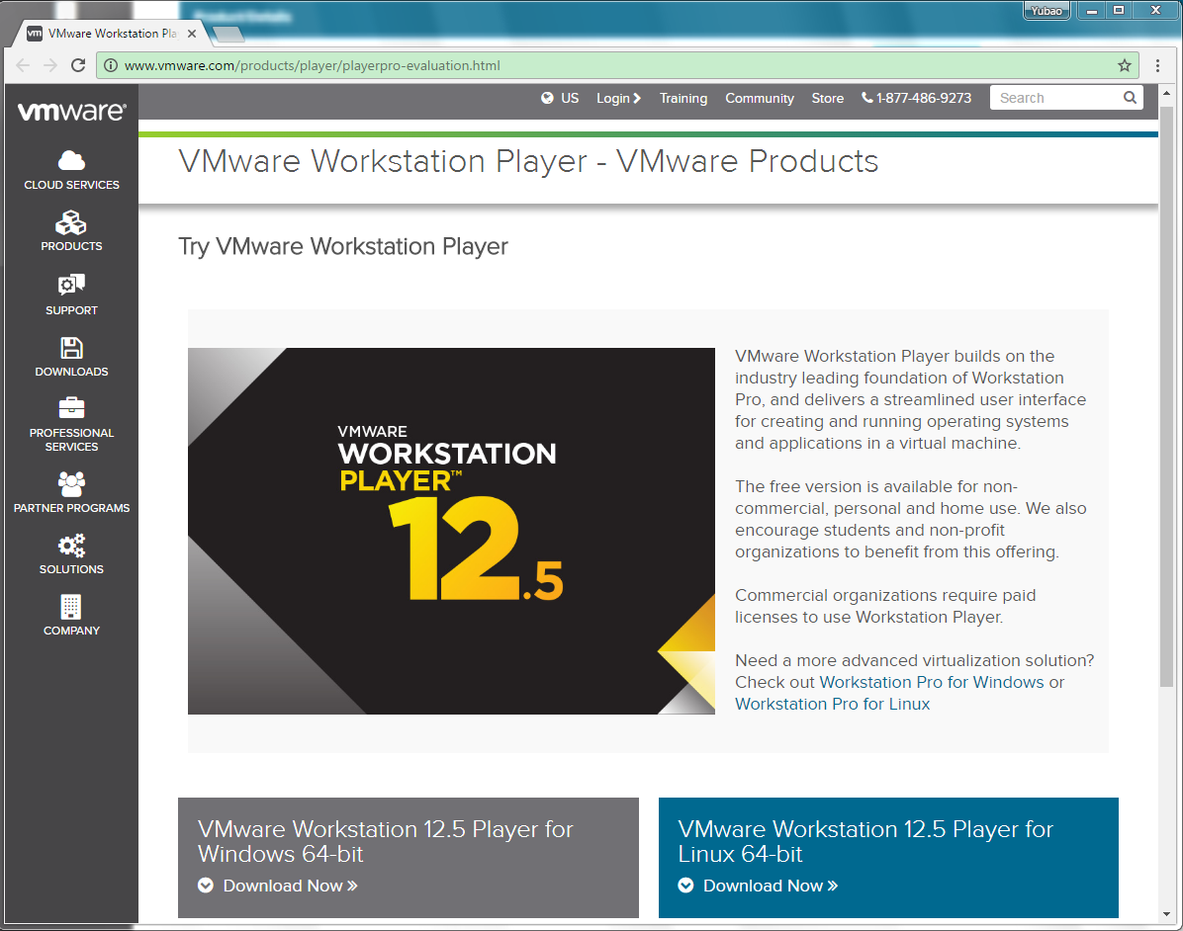
VMware Workstation Player 12.5
This is a free version.

Slide 5

Enable Virtualization Technology (VTx) in HP Laptop
If you are using HP laptop, you may need this to run virtual machine.
ESC => F10 => Security/Configuration => Virtualization Technology (VTx) => (Disabled -> Enabled)

Slide 6
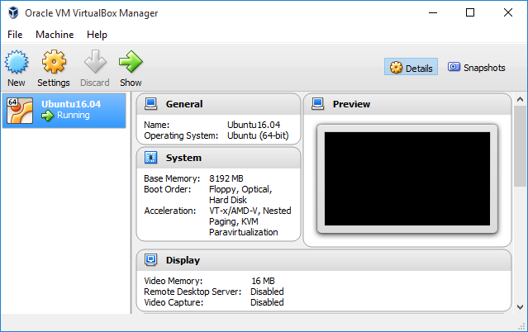
Install Ubuntu First
Ubuntu 16.04.1 LTS (Xenial Xerus)
http://releases.ubuntu.com/16.04/
64-bit PC (AMD64) desktop image
(http://releases.ubuntu.com/16.04/ubuntu-16.04-desktop-amd64.iso)
VirtualBox/Vmware => Ubuntu 16.04 => Java => Hadoop

Slide 7
Installing Java 8
$ sudo apt install openjdk-8-jre-headless
If you get the errors:
E: Could not get lock /var/lib/dpkg/lock - open (11 Resource temporarily unavailable)
E: Unable to lock the administration directory (/var/lib/dpkg/) is another process using it?
Please run the following commands: $ sudo rm /var/lib/apt/lists/lock
$ sudo rm /var/cache/apt/archives/lock
$ sudo rm /var/lib/dpkg/lock
$ java -version
Java is install in “/usr/lib/jvm/java-8-openjdk-amd64”

Slide 8
Hadoop: Setting up a Single Node Cluster
Download hadoop-3.0.0.tar.gz
http://mirror.metrocast.net/apache/hadoop/common/hadoop-3.0.0/hadoop-3.0.0.tar.gz
$ tar -xvf hadoop-3.0.0.tar.gz -C ~/ (or right click -> Extract here)
$ mv hadoop-3.0.0/ hadoop (rename the folder “hadoop” in the home “~/”)
$ cd ~/hadoop/etc/hadoop/
$ gedit hadoop-env.sh
Update the following line ( set the root of your Java installation )
export JAVA_HOME=/usr/lib/jvm/java-8-openjdk-amd64/jre
https://hadoop.apache.org/docs/stable/hadoop-project-dist/hadoop-common/SingleCluster.html

Slide 9
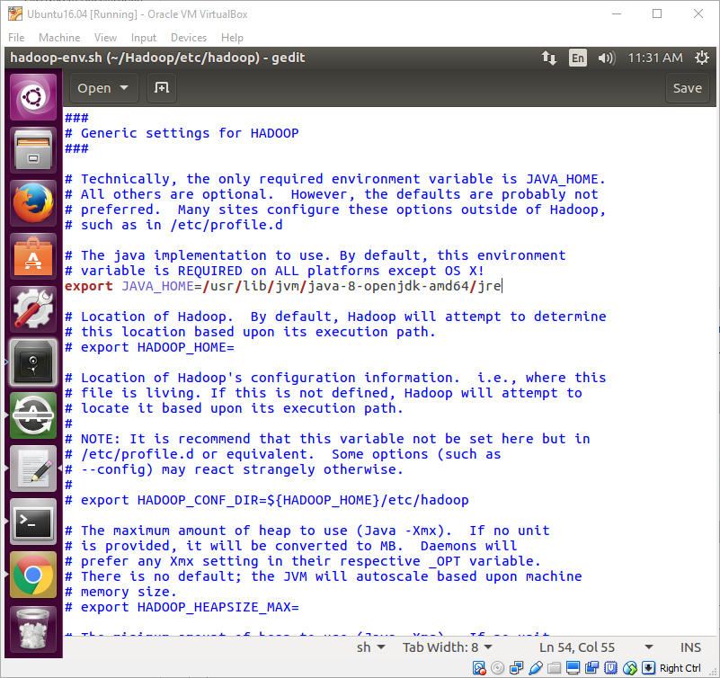
hadoop-env.sh
Location of the file:
~/hadoop/etc/hadoop/
Update the line:
export JAVA_HOME=/usr/lib/jvm/java-8-openjdk-amd64/jre

Slide 10
core-site.xml
<configuration>
<property>
<name>hadoop.tmp.dir</name>
<value>/home/rob/hadoop/tmp</value>
</property>
<property>
<name>fs.defaultFS</name>
<value>hdfs://localhost:9000</value>
<!-- <value>file:///</value> -->
</property>
</configuration>
1. create the /tmp folder in the root directory of Hadoop; It will be used for HDFS.
~/hadoop/tmp/
2. edit the “core-site.xml” file, which is in the directory:
~/hadoop/etc/hadoop/

Slide 11
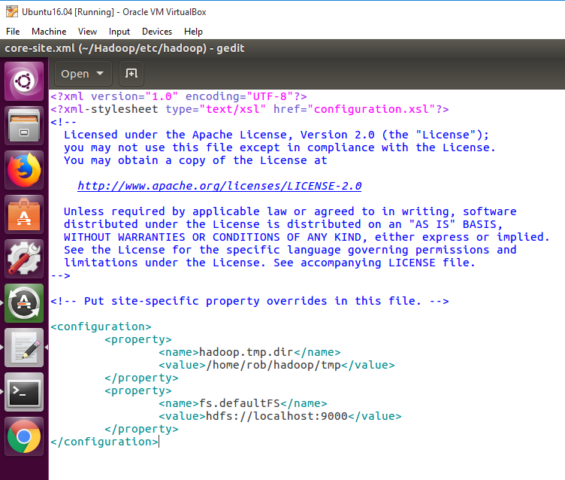
core-site.xml
Location of the file:
~/hadoop/etc/hadoop/
Update the two properties
hadoop jar WordCount.jar /user/rob/data/peterpan.txt /user/rob/peterpan_output

Slide 12
hdfs-site.xml
<configuration>
<property>
<name>dfs.namenode.fs-limits.min-block-size</name>
<value>1048576</value>
</property>
<property>
<name>dfs.blocksize</name>
<value>1048576</value>
</property>
<property>
<name>dfs.replication</name>
<value>1</value>
</property>
</configuration>
Edit the “hdfs-site.xml” file, which is in the directory:
~/hadoop/etc/hadoop/
by default, dfs.blocksize:
134217728 bytes = 128MB
Change it to:
1048576 bytes = 1MB
so we can test the program on small dataset

Slide 13
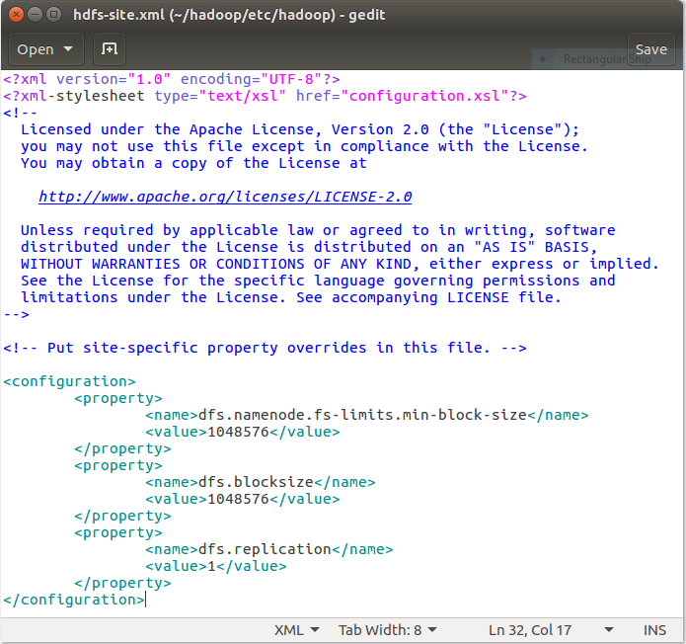
hdfs-site.xml
Location of the file:
~/hadoop/etc/hadoop/
Update the two properties

Slide 14
Hadoop 3.0.0 Defaults
~/hadoop/etc/hadoop/
hdfs-default.xml
dfs.blocksize // 134217728 bytes = 128MB
dfs.replication // 3. Default block replication
https://hadoop.apache.org/docs/r3.0.0/hadoop-project-dist/hadoop-hdfs/hdfs-default.xml
mapred-default.xml
https://hadoop.apache.org/docs/r3.0.0/hadoop-mapreduce-client/hadoop-mapreduce-client-core/mapred-default.xml
core-default.xml
https://hadoop.apache.org/docs/r3.0.0/hadoop-project-dist/hadoop-common/core-default.xml
fs.defaultFS // file:/// local FS is the default
hadoop.tmp.dir // /tmp/hadoop-${user.name}

Slide 15
Hadoop Configuration
Filename | Format | Description
hadoop-env.sh | Bash script | Environment variables that are used in the scripts to run Hadoop
mapred-env.sh | Bash script | Environment variables that are used in the scripts to run MapReduce (overrides variables set in hadoop-env.sh)
yarn-env.sh | Bash script | Environment variables that are used in the scripts to run YARN (overrides variables set in hadoop-env.sh)
core-site.xml | Hadoop config. XML | Configuration settings for Hadoop Core, such as I/O settings that are common to HDFS, MapReduce, and YARN
hdfs-site.xml | Hadoop config. XML | Configuration settings for HDFS daemons: the namenode, the secondary namenode, and the datanodes
mapred-site.xml | Hadoop config. XML | Configuration settings for MapReduce daemons: the job history server
yarn-site.xml | Hadoop config. XML | Configuration settings for YARN daemons: the resource manager, the web app proxy server, and the node managers
slaves | Plain text | A list of machines (one per line) that each run a datanode and a node manager
hadoop-metrics2.properties | Java properties | Properties for controlling how metrics are published in Hadoop (see “Metrics and JMX” on page 331)
log4j.properties | Java properties | Properties for system logfiles, the namenode audit log, and the task log for the task JVM process (“Hadoop Logs” on page 172)
hadoop-policy.xml | Hadoop config. XML | Configuration settings for access control lists when running Hadoop in secure mode

Slide 16
Updating “.bashrc” for Hadoop
$ gedit ~/.bashrc
add the following two lines to the end of the file
export HADOOP_HOME=/home/rob/hadoop
export PATH=$HADOOP_HOME/bin:$PATH
Now, Hadoop is ready to use. But we do not have HDFS.

Slide 17
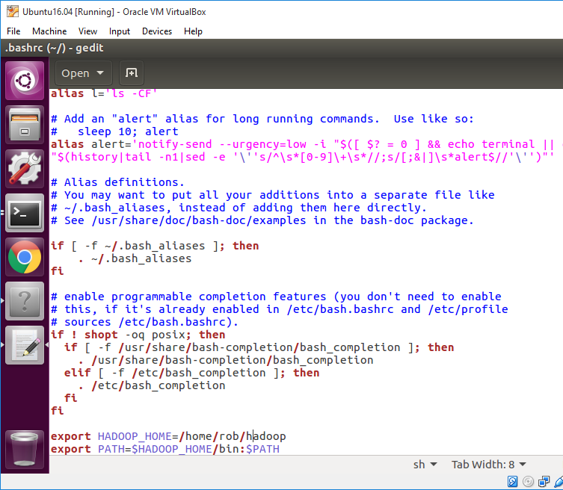
.bashrc
Location of the file:
~/
/home/rob/
The OS will recognize/find “hadoop” when you type it in the terminal.

Slide 18
Setting up HDFS
Pseudo-Distributed Operation
$ sudo apt-get install ssh openssh-client openssh-server
$ sudo ufw allow ssh
$ ssh localhost // it is working now. Not “connection refused”.
If you cannot ssh to localhost without a passphrase, execute the following commands:
$ ssh-keygen -t rsa -P '' -f ~/.ssh/id_rsa
$ cat ~/.ssh/id_rsa.pub >> ~/.ssh/authorized_keys
$ chmod 0600 ~/.ssh/authorized_keys
‘’ : double ‘ (empty passphrase)
You may delete all files in “~/.ssh/” and then re-run all the above three commands
https://hadoop.apache.org/docs/stable/hadoop-project-dist/hadoop-common/SingleCluster.html

Slide 19
Setting up HDFS
You will see all the files in HDFS (files are listed recursively)
bin/hdfs dfs -ls -R hdfs://localhost:9000
$ cd hadoop
$ hdfs namenode -format
$ sbin/start-dfs.sh
$ hdfs dfs -mkdir /user
$ hdfs dfs -mkdir /user/rob
$ hdfs dfs -mkdir /user/rob/data
$ hdfs dfs -put /home/rob/data/peterpan.txt /user/rob/data
$ hdfs dfs -ls /user/rob/data
$ sbin/stop-dfs.sh
hadoop dfs -copyFromLocal <local-dir> <hdfs-dir>
hadoop dfs -put <local-dir> <hdfs-dir>
hadoop dfs -get <hdfs-dir> <local-dir>
https://hadoop.apache.org/docs/stable/hadoop-project-dist/hadoop-common/SingleCluster.html

Slide 20
Setting up HDFS
“Connection refused”?
This is a simple solution. Warning: you may lose all data in HDFS
step 1 : $ ~/hadoop/sbin/stop-all.sh
step 2 : $ hadoop namenode -format
step 3 : $ ~/hadoop/sbin/start-all.sh
https://wiki.apache.org/hadoop/ConnectionRefused
https://stackoverflow.com/questions/28661285/hadoop-cluster-setup-java-net-connectexception-connection-refused
https://apple.stackexchange.com/questions/153589/trying-to-get-hadoop-to-work-connection-refused-in-hadoop-and-in-telnet

Slide 21
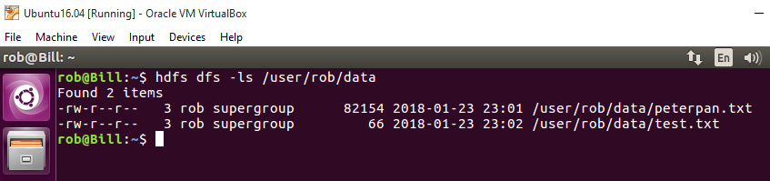
Apache Hadoop 2.4.1 - File System Shell Guide
https://hadoop.apache.org/docs/r2.4.1/hadoop-project-dist/hadoop-common/FileSystemShell.html
Following are the three commands which appears same but have minute differences
$ hadoop fs {args}
$ hadoop dfs {args}
$ hdfs dfs {args}

Slide 22
Apache Hadoop 2.4.1 - File System Shell Guide
https://hadoop.apache.org/docs/r2.4.1/hadoop-project-dist/hadoop-common/FileSystemShell.html
Following are the three commands which appears same but have minute differences
$ hadoop fs {args}
$ hadoop dfs {args}
$ hdfs dfs {args}
A directory at Hadoop HDFS
$ hadoop fs -put YourLocalFile /user/rob/data/
$ hadoop fs -put peterpan.txt /user/rob/data/

Slide 23
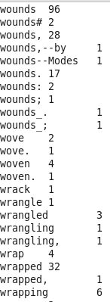
Running the WordCount example
Command to run a “.jar” file
<file:///> or <hdfs://namenode:port>
$ hadoop jar WordCount.jar /user/rob/data/peterpan.txt /user/rob/peterpan_output
Local Runnable JAR file
Input file
Output Directory
Show the content of the output file
$ hadoop fs -cat /user/rob/peterpan_output/part-r-00000
Download the output file
$ hadoop fs -get /user/rob/peterpan_output/* ~/data/
Hadoop Commands Guide:
https://hadoop.apache.org/docs/current/hadoop-project-dist/hadoop-common/CommandsManual.html

Slide 24
Directories in HDFS and FS
The full directory of “peterpan.txt” in HDFS
hdfs://localhost:9000/user/rob/data/peterpan.txt
host:port/directory localhost=127.0.0.1
The full directory of “peterpan.txt” in the local file system (FS)
file:///home/rob/data/peterpan.txt
<file:///> or <hdfs://namenode:port>
Hadoop Commands Guide:
https://hadoop.apache.org/docs/current/hadoop-project-dist/hadoop-common/CommandsManual.html

Slide 25
Running the WordCount example
Command to run a “.jar” file
<file:///> or <hdfs://namenode:port>
$ hadoop jar WordCount.jar file:///home/rob/data/test.txt file:///home/rob/test_output
Local Runnable JAR file
Local Input File
Local Output Directory
Show the content of the output file
$ hadoop fs -cat /user/rob/peterpan_output/part-r-00000
Download the output file
$ hadoop fs -get /user/rob/peterpan_output/* ~/data/
Hadoop Commands Guide:
https://hadoop.apache.org/docs/current/hadoop-project-dist/hadoop-common/CommandsManual.html

Slide 26
Check whether Hadoop processes are running or not
A nifty tool for checking whether the expected Hadoop processes are running is jps - Java Virtual Machine Process Status Tool
$ sudo apt install openjdk-8-jdk-headless
$ jps
2287 TaskTracker
2149 JobTracker
1938 DataNode
2085 SecondaryNameNode
2349 Jps
1788 NameNode

Slide 27
Check who is listening
You can also check with netstat if Hadoop is listening on the configured ports.
$ sudo netstat -plten | grep java
tcp 0 0 0.0.0.0:50070 0.0.0.0:* LISTEN 1001 9236 2471/java
tcp 0 0 0.0.0.0:50010 0.0.0.0:* LISTEN 1001 9998 2628/java
tcp 0 0 0.0.0.0:48159 0.0.0.0:* LISTEN 1001 8496 2628/java
tcp 0 0 0.0.0.0:53121 0.0.0.0:* LISTEN 1001 9228 2857/java
tcp 0 0 127.0.0.1:54310 0.0.0.0:* LISTEN 1001 8143 2471/java
tcp 0 0 127.0.0.1:9000 0.0.0.0:* LISTEN 1001 9230 2857/java
tcp 0 0 0.0.0.0:59305 0.0.0.0:* LISTEN 1001 8141 2471/java
tcp 0 0 0.0.0.0:50060 0.0.0.0:* LISTEN 1001 9857 3005/java
tcp 0 0 0.0.0.0:49900 0.0.0.0:* LISTEN 1001 9037 2785/java
tcp 0 0 0.0.0.0:50030 0.0.0.0:* LISTEN 1001 9773 2857/java

Slide 28
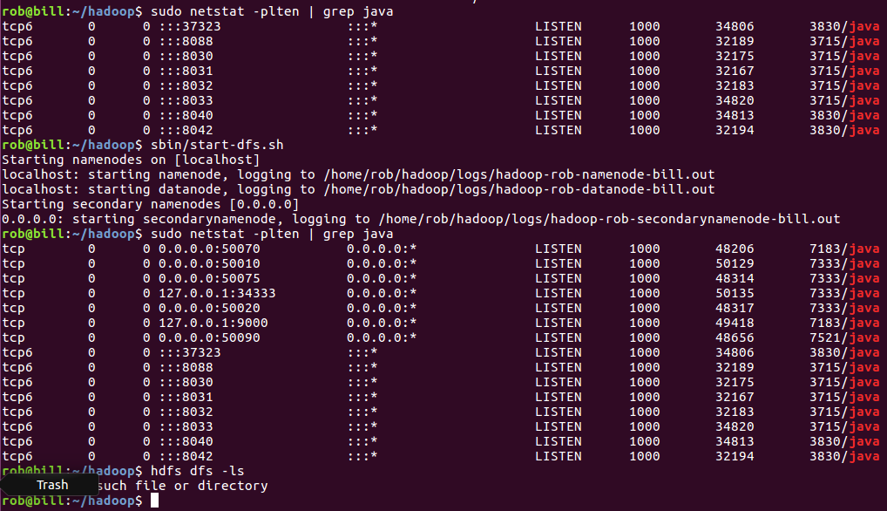
Setting up HDFS
127.0.0.1 (localhost) is listening
Before strating DFS
After

Slide 29
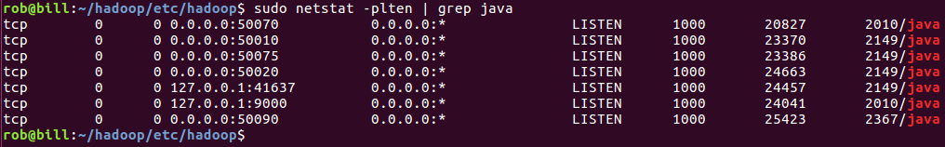
Hadoop Administration: localhost:50070

Slide 30
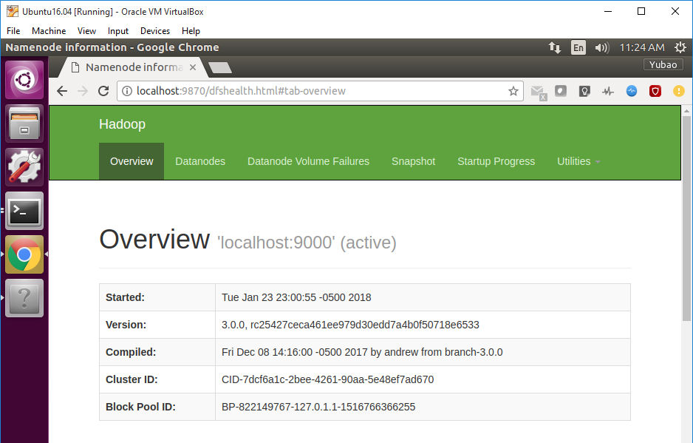
NameNode Web UI
open a web browser and enter the URL:
port 50070 changed to 9870 in 3.0.0-alpha1
localhost:9870

Slide 31
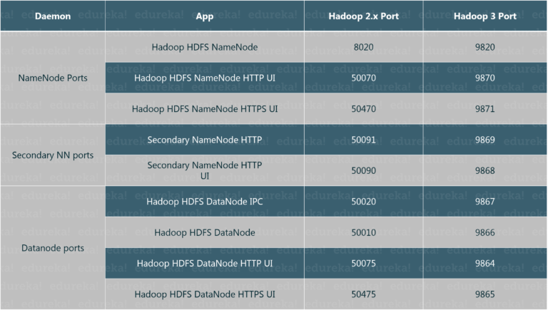
https://www.edureka.co/blog/hadoop-3/

Slide 32
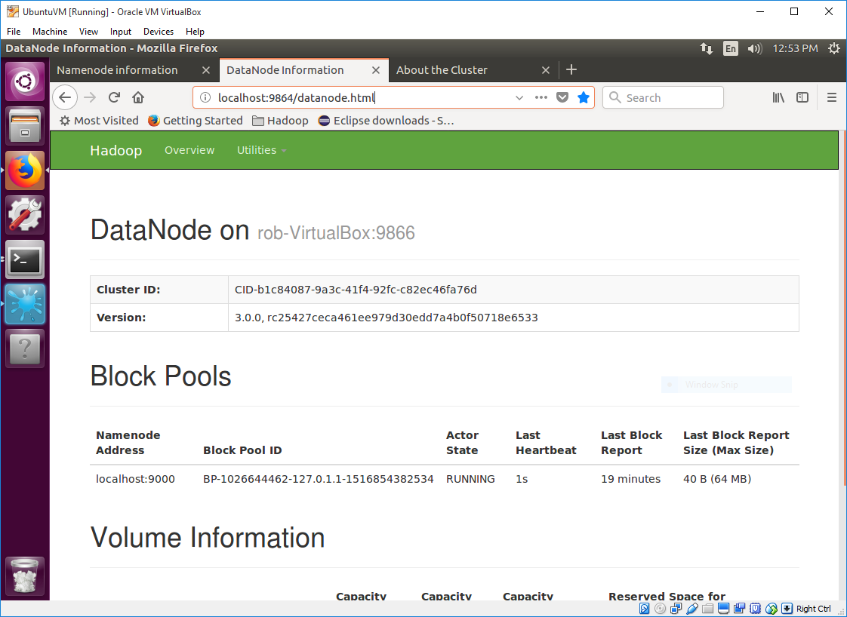
DataNode Web UI
open a web browser and enter the URL:
localhost:9864

Slide 33
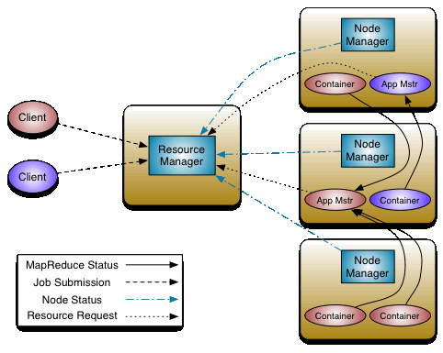
YARN
/hadoop/sbin/start-yarn.sh
yarn jar WordCount.jar /input /output
Yet Another Resource Negotiator
The fundamental idea of YARN is to split up the functionalities of resource management and job scheduling/monitoring into separate daemons. The idea is to have a global ResourceManager (RM) and per-application ApplicationMaster (AM). An application is either a single job or a DAG of jobs.

Slide 34
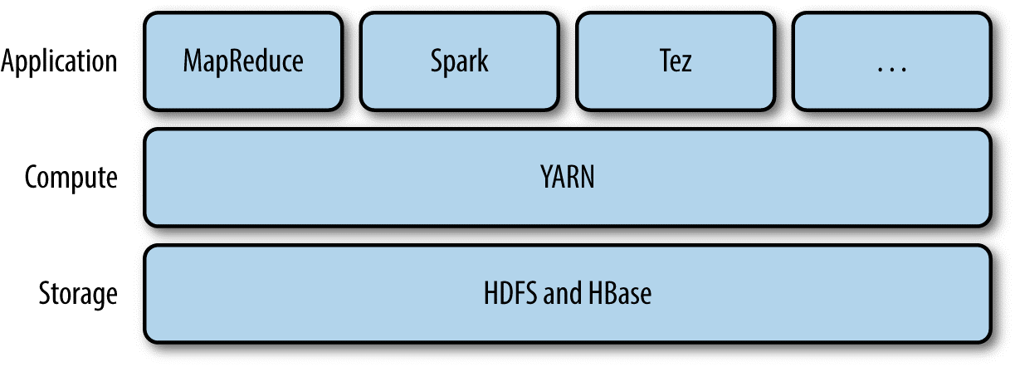
YARN Application

Slide 35
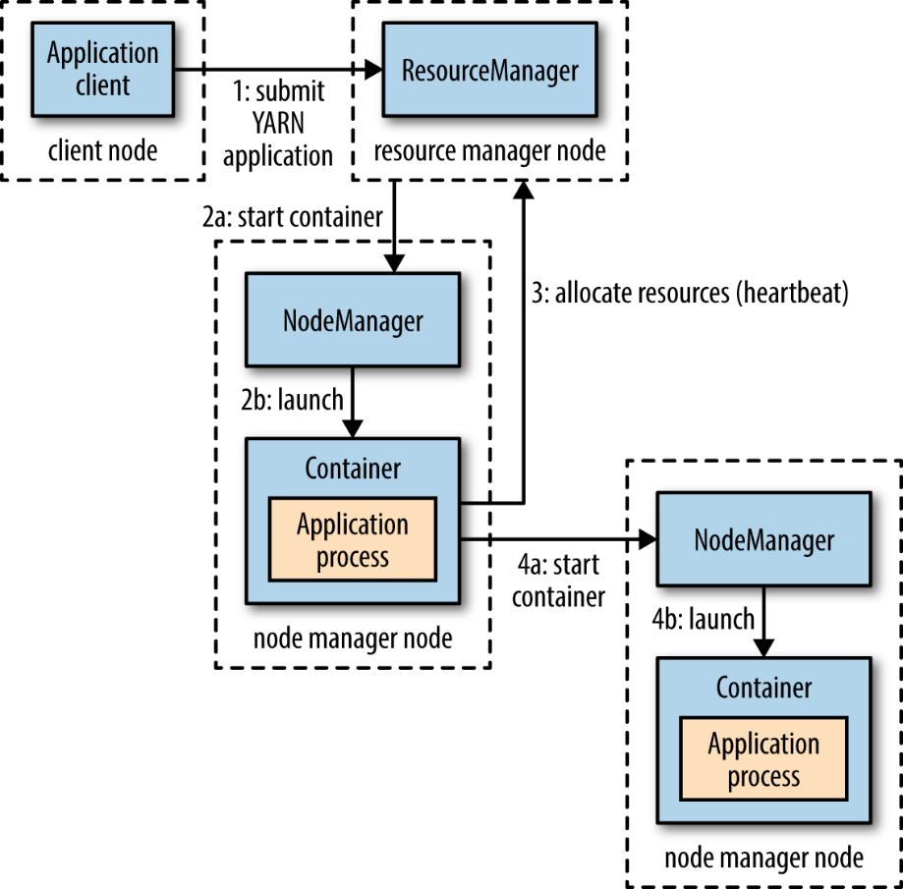
How YARN runs an application?

Slide 36
Difference between MRv1 and MRv2
MRv1 | MRv2
MRv1 uses the JobTracker to create and assign tasks to data nodes, which can become a resource bottleneck when the cluster scales out far enough (usually around 4,000 nodes). | MRv2 (aka YARN) has a Resource Manager for each cluster, and each data node runs a Node Manager. For each job, one slave node will act as the Application Master, monitoring resources/tasks, etc.
MRv1 which is also called as Hadoop 1 where the HDFS (Resource management and scheduling) and MapReduce (Programming Framework) are tightly coupled. Because of this non-batch applications can not be run on the hadoop 1. It has single namenode so, it doesn't provides high system availability and scalability. | MRv2 (aka Hadoop 2) in this version of hadoop the resource management and scheduling tasks are separated from MapReduce which is separated by YARN. The resource management and scheduling layer lies beneath the MapReduce layer. It also provides high system availability and scalability as we can create redundant NameNodes. The new feature of snapshot through which we can take backup of filesystems which helps disaster recovery.

Slide 37
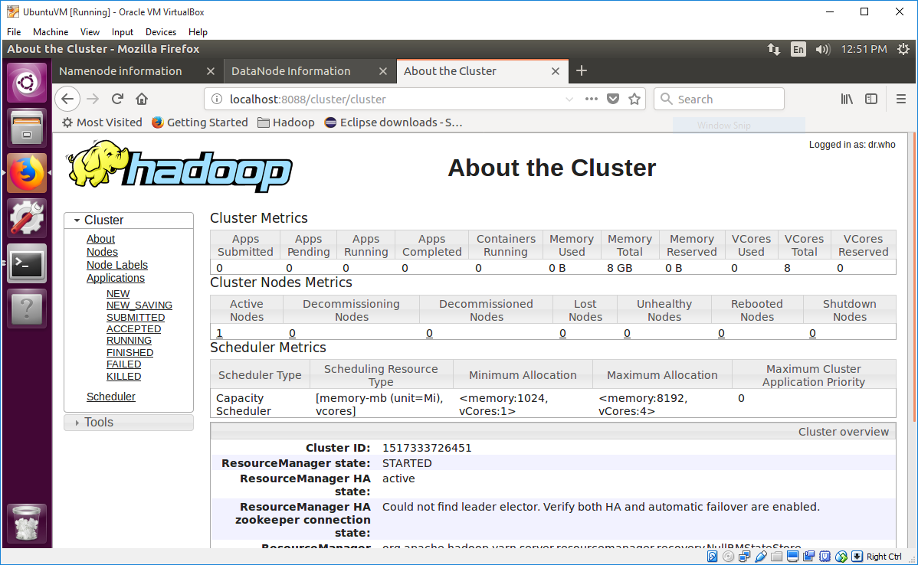
YARN Web UI
localhost:8088

Slide 38

Installing and Using Eclipse in Ubuntu
Download Eclipse from its website
https://www.eclipse.org/downloads/
Download 64 bits
Unzip the file “eclipse-inst-linux64.tar.gz” and go to “eclipse-installer” folder
click on the file “./eclipse-installer/eclipse-inst”
Installation folder: “/home/rob/eclipse/java-oxygen”
Add external Jar files to your java project
/home/rob/hadoop/share/hadoop/common/hadoop-common-3.0.0.jar
/home/rob/hadoop/share/hadoop/mapreduce/hadoop-mapreduce-client-core-3.0.0.jar

Slide 39
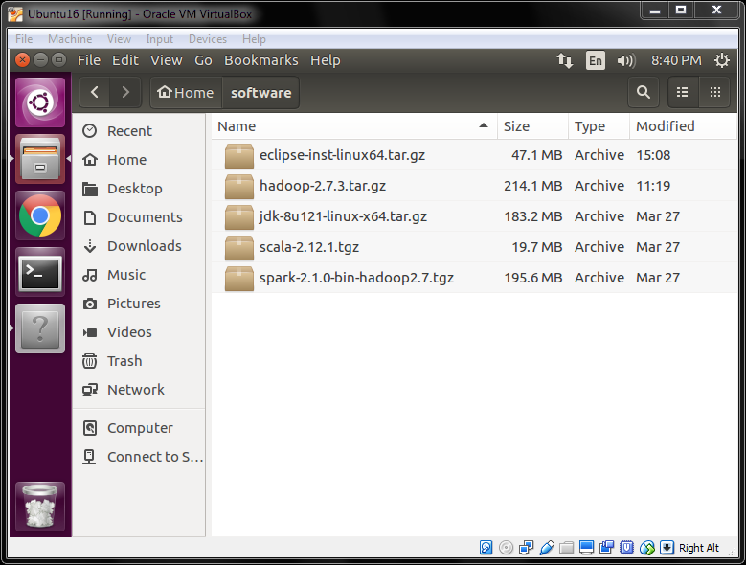
Downloads
1. Download the files
2. Unzip the files
3. Set the environment variables in .bashrc

Slide 40
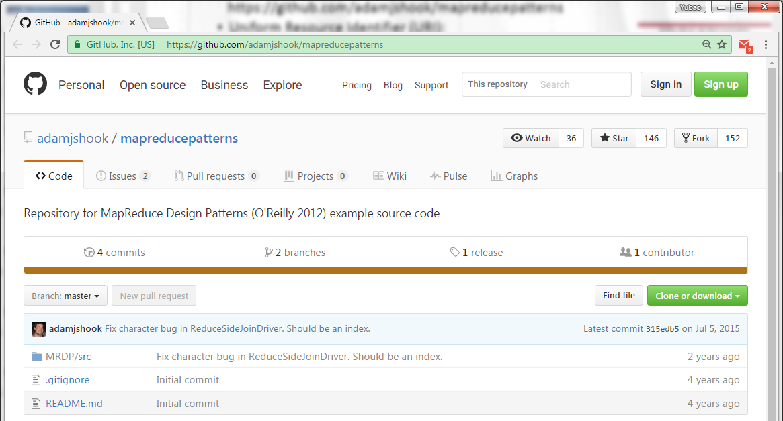

Source Code for the Examples in the Textbook
GitHub https://github.com/adamjshook/mapreducepatterns

Slide 41
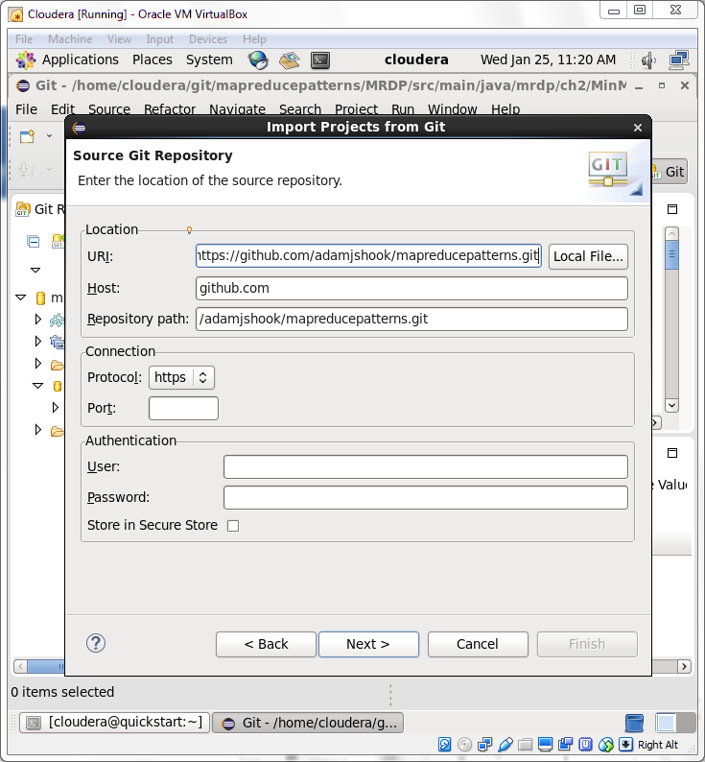
Import Project From Git
Eclipse => File => Import => Git => Projects from Git => Clone URI =>
GitHub URI (Uniform Resource Identifier): https://github.com/adamjshook/mapreducepatterns.git
Select the master branches => Next

